Slide 1
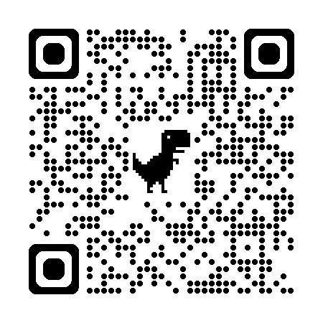
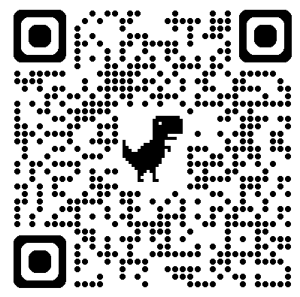

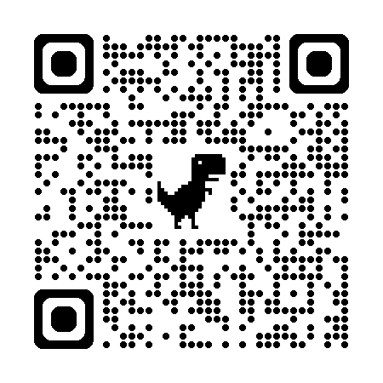
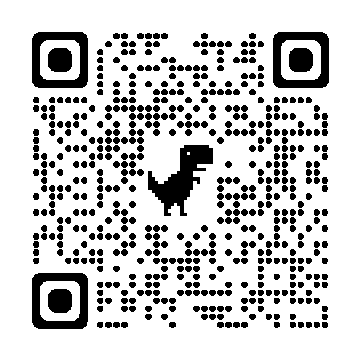
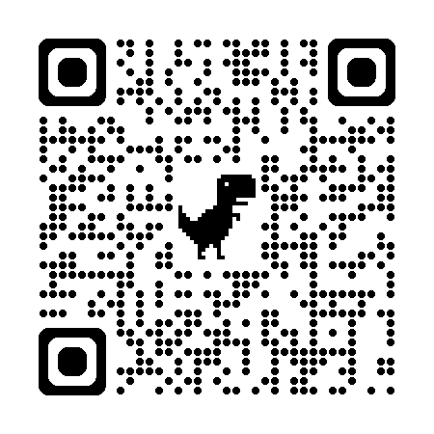

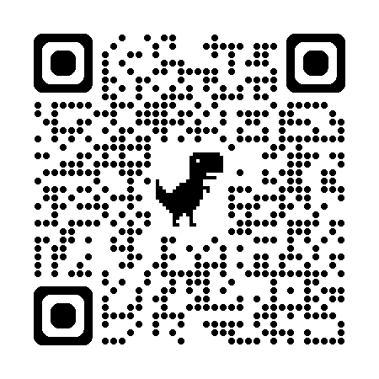



Data Collection, Integration and Analysis: Create a system for processing and analyzing sensor data to inform maintenance and operational decisions. Integrate data from weather patterns, urban infrastructure, water quality and quantity sensors, and satellite imagery.
Stormwater systems are complex systems, and their main objective is to move runoff as quickly as possible away from areas where it could cause harm to human health or property, sometimes with little regard for the natural surroundings. However, because these systems are in constant contact with the environment and are close to people, they are exposed to unexpected events such as debris flow, mud flow, sewage inflow, and others, which can affect data collection, dissemination and quality.
Assignment: How to make decisions under uncertainty and/or evaluate the quality of data and systematize the QA/QC processes to increase the use cases of data?
Estonian Demo sites:
Recommended research articles for background information:
Demo site locations
Haapsalu | 18301:008:0034 | Potissepa tn 3
Narva | 51107:031:0317 | AÜ Elektron üldmaa
Rakvere | 66301:001:0449 | Vabriku tn 16
Viimsi | 89001:001:1904 | Mereranna tee L4
Võru | 91901:013:0118 | F. R. Kreutzwaldi tn 85b

